Slide 1

Airline Maintenance Schedule Optimization

Slide 2
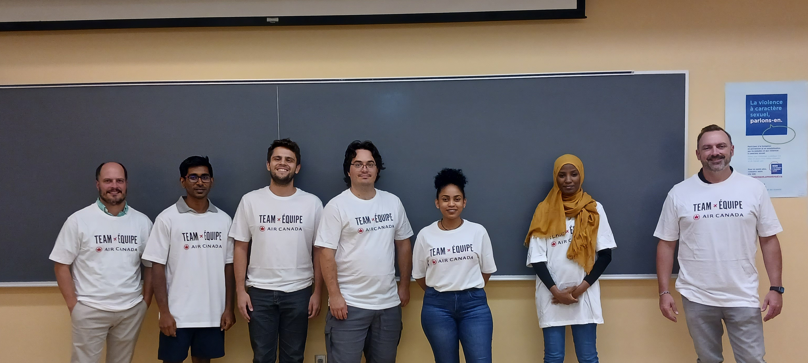
Keith
Warley
Frederic
Rahim
Prakash
Samah
Hewan

Slide 3

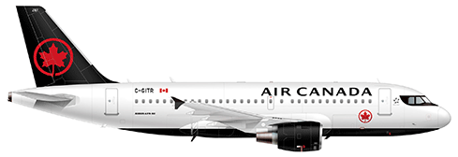
Introduction
Preventive Maintenance – As late as possible
FIN - 5496
Repair Defects – As soon as possible
Tasks defined by a Due Date and Duration

Slide 4

Problem Description
Ground Times
Block Times
F-295
F-295
F-295
YYZ
YUL
YVR

Slide 5
Problem - Hardness
Matching task duration with a ground time
Limited resources to perform tasks in an airport
Assigning FIN Number to ground time
Optimize yield remaining
Yield Remaining – Time until due date

Slide 6
Data
Ground times –
Maintenance Tasks –
Defect Repairs –
Resource Availability –
Flight Date | Fleet Type | Departing Station | Inbound Arrival Local Time | Ground Minutes
Fleet Type | DUE_DATE | MAN_HOURS_VALUE
Fleet Type | DEFECT_TYPE | DEFECT_ITEM | PLAN_PROJECTED_DUE_DATE | MAN_HOURS_VALUE
Month | Cycle | Location | Fleet | Headcount

Slide 7
Data Analysis – Due Dates
Distribution – Due date for Repair tasks
Distribution – Due date for Maintenance tasks

Slide 8
Data Analysis – Task Times
Distribution – ManHours requirement in hours for repair
Distribution – ManHours requirement in hours for maintenance

Slide 9
Data Analysis - YYZ
Distribution – Volume of flights per day
Distribution – Ground time available in minutes

Slide 10
Data Analysis - Manpower
 | FLEET
Location | F670 | F192 | F546 | F295 | F690 | F855 | F630 | F231 | F286
YUL | 41 | 20 | 5 | 15 | 22 | 11 | 16
YYT | 2 | 0 | 0 | 0 | 0 | 0 | 1
YOW | 2 | 1 | 0 | 0 | 0 | 0 | 1
YHZ | 2 | 2 | 0 | 0 | 0 | 0 | 2
YQB | 1 | 0 | 0 | 0 | 0 | 0 | 2
YYZ | 98 | 60 | 20 | 40 | 49 | 38 | 35
YVR | 36 | 18 | 4 | 12 | 19 | 12 | 15
YYC | 6 | 2 | 0 | 2 | 4 | 3 | 3
YEG | 2 | 2 | 0 | 0 | 0 | 0 | 1
YWG | 2 | 1 | 0 | 0 | 0 | 0 | 1
Number of employees available at each airport

Slide 11
Solution Approach
Decompose by fleet
Shift Profile – Assign of employees to shifts
Task Assignment – Assign tasks to ground times
Resource Usage – Assign employees from a shift to a task

Slide 12
Shift Profile
Given – available manpower in an airport
To divide the manpower within 4 shifts.
Shifts
Morning
Afternoon
Evening
Night

Slide 13
Shift Profile - YYZ
Month | Cycle | Location | F347 | F295 | F690 | F855 | F630 | F231 | F286
August | 1 | YYZ | 92 | 50 | 15 | 36 | 49 | 33 | 35
August | 2 | YYZ | 92 | 50 | 15 | 36 | 50 | 32 | 35
Shifts do not have balanced volume of flights to handle
Distribute manpower Proportional to the volume of flights

Slide 14
Task assignment – First Approach
Integer programming
Issues :
Constraining resource usage on overlapping ground times
May be revisited in the future…
Discretizing time
Forbid teams to work other ground times
Constraint Programming – (Interval Sequencing)
Preassigning manpower to ground times

Slide 15
Task assignment
Greedy heuristic
Rank tasks by their score (combination of priority manhours, and due date)
Rank ground times by date
Assign tasks to ground times:
Defect as early as possible
Maintenance as late as possible
Respect assigned FIN numbers
Log tasks that cannot be assigned at all

Slide 16
Task assignment
Integer programming
Issues :
Constraining resource usage on overlapping ground times
May be revisited in the future…
Discretizing time
Forbid teams to work other ground times
Constraint Programming – (Interval Sequencing)
Preassigning manpower to ground times

Slide 17
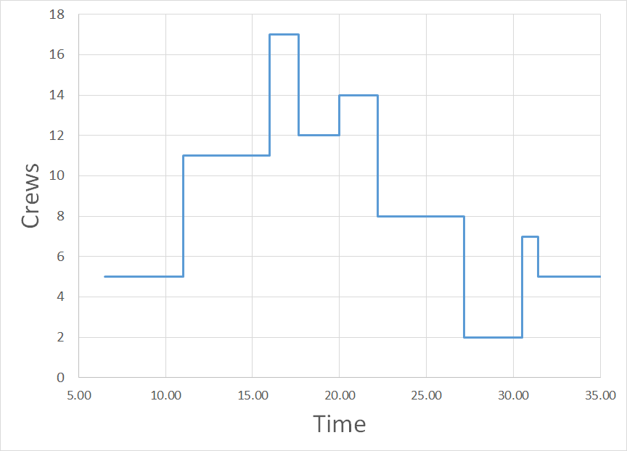
Resource Usage

Slide 18
Results
Distribution – yield remaining for repair tasks
Distribution – yield remaining for maintenance tasks

Slide 19
Results
Mean yield remaining for repair tasks
Mean yield remaining for maintenance tasks

Slide 20
Results

Slide 21
Results
Fleet type | Runtime (minutes)
F-231 | 11.2
F-286 | 15.1
F-295 | 17.7
F-630 | 25.4
F-855 | 8.1

Slide 22
Final remarks
The generation of the shift profile based on ground times gives appropriate results
The greedy heuristic finds good feasible solutions in a reasonable amount of time
The greedy heuristic can thrive with a more detailed implementation of the algorithm
The integer programming idea can be further developed to better describe the problem
The greedy heuristic can profit from having better set parameters (e.g., task scoring)
There could also be some sensitivity analysis on the change of shift profile
There could be a local search outside of the greedy heuristic to decide the shift profile

Slide 23
Thank you
Merci

Slide 24

Problem Statement
At Air Canada Maintenance we must maintain our aircraft through a defined preventative maintenance program using accumulated hours/cycles and/or calendar days on our assets since their last maintenance activity. We incidentally also have defects that occur along the way and naturally we must fix those within similar constrained thresholds of hours/ cycles or calendar days.
We must plan the maintenance program items down to the day of execution without losing yield, whereas we must plan to rectify the defects as soon as possible without overrunning the due dates derived from the limits on the hours/ cycles or calendar days, while accounting for a limited number of resources available to perform the work required at multiple locations.
The objective of this problem is to build a forecasted maintenance plan that combines competing goals: minimize the yield remaining at the due date for a given task per asset and maximize the yield remaining for a defect that has occurred along the way. Upper bounds on available resources and ground time availability at multiple stations must also be considered.
*Privileged and Confidential

Slide 25
Maintenance Program
Defects
Limits set by the Original Aircraft Manufacturer (OAM), Original Equipment Manufacturer of our components (OEM) and our Engineers to ensure we maintain the structural integrity, reliability, safety and Airworthiness of our fleet.
Despite having a well-defined preventative maintenance program, items still break along the way. We call these defects, and/or snags at Air Canada
(Also known as squawks or complaints outside of AC).
Defined in Trax as
Defined in Trax as
Engineer Controls (EC’s), PN Engineering Controls (PN EC’s), PN Controls
Defect Type L, M, C or E
Thresholds controlled by
Thresholds controlled by
Defining our Limits
Hours, Cycles, Calendar Days or inherent EC
Hours, Cycles or Calendar Days
Thresholds defined by
Created By
Minimum Equipment List (MEL)
Defect type L & MEL Category A, B, C or D Non-MEL Defect Type C, M or E
ACM Engineering and System Configuration
Through combining our maintenance planning document with our aircraft utilization ratio and calendar days we derive the maintenance program and defect due dates for our engines, airframe events, landing gear removals, component removals, as well as our line maintenance resource requirements to maintain our fleet… all the while applying our objective functions to obtain an optimal strategy.
Taxonomy
Reported By
Input data - Mostly Structured and reliable
Output data – Historical is paper based with digital starting Q4 2022
Anyone that identifies the defect
Taxonomy
Input/Output is paper based but digitalized post initial report… Taxonomy is unreliable
Corpus for the 2022 IPSW
Will be provided if you select this problem to solve
*Privileged and Confidential

Slide 26
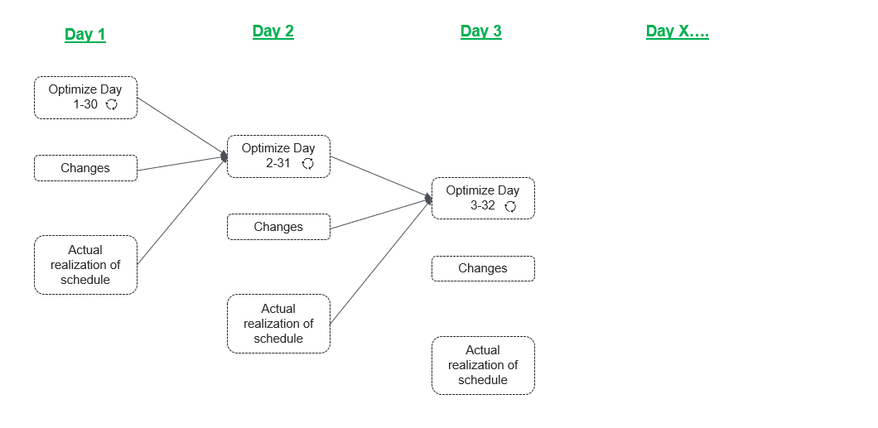
MAINTENANCE PLANNING
Input
Due dates for both maintenance program and defects
Ground time per aircraft, opposite the block time (Commercial Schedule )
Available man hours and available defects man hours
Location: man-hours available by location by skill
Cost of yield loss per task (to be derived)
Aircraft type to home base assignment (to be derived)
Engine Maintenance Planner
Short term view
Output
Scheduled Maintenance Events for 30 days, and give feasible solution for 31 days to 2 years
When (24h 7w 365d) and
where (what location) to fix everything (based on ground time availability at location) Identify where work can be performed considering constraints, and lost opportunities
*Privileged and Confidential

Slide 27

Closer look at the LT horizon view for the bigger picture we have to solve
Day 1
Day 90
+90 day
+90 day
2 yrs
Line Mtce
View every 90 days over a 2-year interval
optimization
……..
A Check interval
A Check interval
A check interval
*Privileged and Confidential

Slide 28
Appendix

Slide 29
Cost of Yield Loss
Consider the total cost of ownership for any asset increases the more times your maintenance events repeat.
An aircraft can operate for over 30 years, many tasks have repeat intervals, just like changing the oil in your car.
Performing a MPD task earlier than its due date might mean that you will have to do it more than once prior to the aircraft retirement.
It is favourable then to minimize the yield remaining at that due date, however at times, the ground time and resource availability and the competing objective functions might not allow for that to occur.
Therefore, it is important to provided a weighted cost of loss in yield into the model to ensure that the weighted cost is used to solve for optimality.
*Privileged and Confidential

Slide 30
Aircraft Type Home-Base
How to Derive the Aircraft type home-base
Through constant iteration of planning our maintenance schedule day over day and year over year it quickly becomes apparent where the Aircraft type home-base is located through repetitive opportunities constantly occurring in the same location.
Algorithmically defining it however is a slightly different challenge. To derive it, consider the following. Every aircraft will fly multiple missions throughout the course of a single day. As soon as that flying schedule allows for more than 4 hours of ground time at XXX location considering all available FINs within the same aircraft type, we can build an entire overnight work order package at that location. The instantiation of most of the available ground time opportunities where that criteria is met, allows us to declare XXX location as the Home-Base. Consider that a single aircraft rolls up into an Aircraft type, and all fins that are of the same aircraft type share the same flight schedule.
Ground time availability does not designate touch time on the Aircraft. A minimum 1-hour buffer should be applied to the ground time.
*Privileged and Confidential

Slide 31
About Air Canada

Slide 32



Overview | MARCH 2022 2
In the community
Air Canada has been part of Canadians’ lives and given back to communities across Canada for over 80 years. Established as a registered charitable organization in 2012, the Air Canada Foundation’s mission is focused on the health and well-being of children and youth in Canada and on helping connect sick children to the medical care they need away from home, granting children’s wishes and alleviating child poverty.
The Foundation works towards its mission by:
Offering financial and in-kind support to Canadian registered charities.
Donating Aeroplan points to
15 paediatric hospitals across Canada, enabling children to access the medical care they need away from home.
Supporting employees’ philanthropy in their local communities by providing airline tickets for charity fundraising.
Raising funds through its Every Bit Counts program, which encourages customers to donate spare change of any denomination on board flights or through airport collection containers.
Holding an annual golf tournament to raise funds; its ninth annual golf tournament in 2021 netted over
$765,000 in support of children’s organizations.
The Air Canada Foundation also partners with Canadian NGOs in times of disaster, both locally and internationally, and supports major health-related causes.
Donate cash or Aeroplan points today at aircanada.com/foundation .
TRAVEL POLICY FOR BOOKING WITH COMPLETE CONFIDENCE
Air Canada’s new refund policy applies to all tickets purchased. The airline offers options including a refund to the original form of payment, an Air Canada travel voucher or the equivalent in Aeroplan points plus an additional 65% bonus if Air Canada has to cancel a flight or change the schedule by more than three hours.
ARE YOU TRAVELLING ABROAD?
Passengers are responsible for making sure they meet all government entry requirements, including all required travel documents, visas, health certificates and comply with all other entry criteria.
Check Air Canada’s Travel Ready Hub for the most recent government entry requirements. Government requirements may change at short notice.
SCAN YOUR COVID-19 TRAVEL DOCUMENTS
Air Canada’s digital solution is available on select routes through its mobile app for customers to securely upload and verify their COVID-19 test results. This feature will help travellers conveniently validate compliance with government health travel requirements prior to arriving at the airport.
New On-board Safety video
Ode to Canada is Air Canada’s new on-board
pre-flight safety video that takes customers on
a stunning journey across Canada from coast- to-coast-to-coast to each province and territory
through all four seasons while presenting aircraft safety instructions in an compelling way.

Slide 33





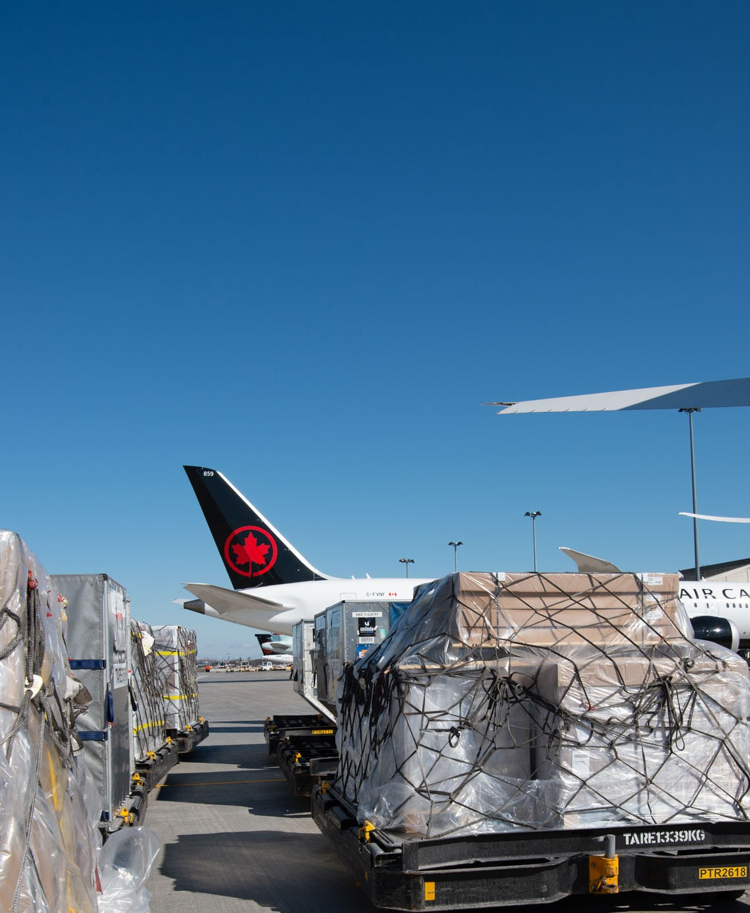
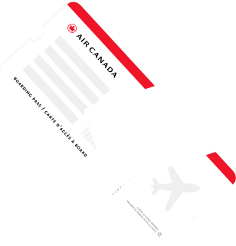

Overview | MARCH 2022 3
Air Canada Cargo Business
Air Canada Cargo, the freight division of Air Canada, provides services within Canada and to major cities around the world. In March 2020, it re-engineered its business model from primarily transporting
cargo in the belly of passenger aircraft to launching cargo-only flights, including temporarily modifying several widebody aircraft to double cargo capacity. To date, over 14,000 cargo flights have been completed, playing a valuable role in maintaining the global supply chain by providing critical capacity that allows medical supplies, food and consumer goods to reach communities around the world.
In late 2021, the first dedicated Boeing 767-300ER freighter aircraft joined the Air Canada fleet to provide consistent capacity on key air cargo routes such as Toronto to Miami, Quito, Lima, Mexico City
and Guadalajara, with more routes being added as additional aircraft enter service.
Air Canada Cargo’s robust network connects through its main hubs in Toronto, Montreal and Vancouver.
(aircanada.com/cargo )
FLEET AND OPERATIONS
INNOVATION
SAF AND CLEAN ENERGY
CARBON REDUCTION AND REMOVALS
Commits to Net Zero Emissions by 2050
Air Canada has committed to a net zero emissions goal from all global operations by 2050, demonstrating its long-term commitment to advancing climate change sustainability throughout its business. To reach this, Air Canada has set absolute midterm GHG net reduction targets by 2030 in its air and ground operations compared to its 2019 baseline.
—
Aeroplan
Air Canada’s Aeroplan is Canada’s leading travel loyalty program, chosen by millions of travellers worldwide. Aeroplan helps members travel more and offers the ability to earn or redeem points on all Air Canada fights as well as the world’s largest airline partner network, encompassing over 40 airlines serving hundreds of destinations across the globe.
Members earn points with Aeroplan’s 150+ financial, retail, and travel partners, including online shopping via the Aeroplan eStore . In addition to flights, members also have access to an extensive range of merchandise, hotel and
car rental rewards.
Aeroplan offers members exceptional benefits including obtaining flight rewards more quickly by combining points with Aeroplan Family Sharing, and saving on redemptions with no additional cash surcharges on Air Canada flights. Aeroplan’s unique everyday partnerships with
Uber Canada, Starbucks®, and LCBO enable members to earn points directly when making a purchase.
Plus, Aeroplan Elite™ Status Members and eligible Aeroplan credit cardholders have access to additional benefits, such as preferred pricing on flight rewards, lounge access, and more.
(aircanada.com/aeroplan )

Slide 34


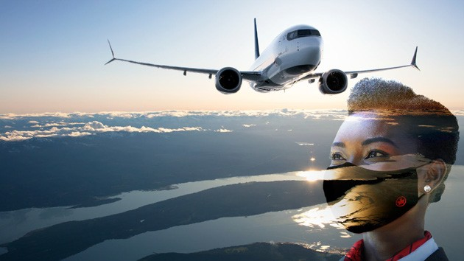
















Overview | MARCH 2022 4
Air Canada CleanCare+
Corporate Citizenship
Air Canada is committed to end-to-end health and safety
protocols. Using leading biosafety standards and enhanced preventive measures, the airline has refined its processes to keep
customers safe throughout the travel experience, putting safety
2020
first, always.
Check-in
CORPORATE SUSTAINABILITY REPORT
CITIZENS OF THE WORLD
^{BEGIN} >
Health screening questions, touch-free check-in processes, and validation of health-
related travel documentation pre-travel on select routes, as well as the disinfection
“I feel proud to have supported our country and fellow Canadians during these unprecedented times. Working with the Red Cross gave me a chance to give back in a meaningful way.” – Air Canada employee Ameena Youssef on working with the Canadian
Red Cross in their fight against COVID-19
With the help of employees like Ameena and others, Air Canada supports communities in need across the country for various causes. This is one example
of many other actions and accomplishments outlined in Air Canada’s 2020 corporate sustainability report, Citizens of the World .
As a global airline and as citizens of the world, Air Canada aims — in everything it does — to integrate economic, environmental, and social factors organized into three sustainability pillars: Our Business, Our People and Our Planet.
(aircanada.com/CSR ).
of frequently touched areas such as check-in counters and kiosks, are just some of
the measures implemented for customer safety.
Boarding
Ongoing cleaning at gate areas, regular health screening questions for all
customers, adjusted boarding processes facilitating physical distancing and
mandatory face coverings for all employees and customers are steps designed
to protect everyone on board.
On board
All high-touch areas are sanitized with a hospital-grade disinfectant before
every flight, and each time an aircraft overnights it receives a thorough cleaning.
Additional preventive measures like mandatory face coverings, personal care
kits and adjusted onboard services are also in place to better protect customers
and employees.

Slide 35
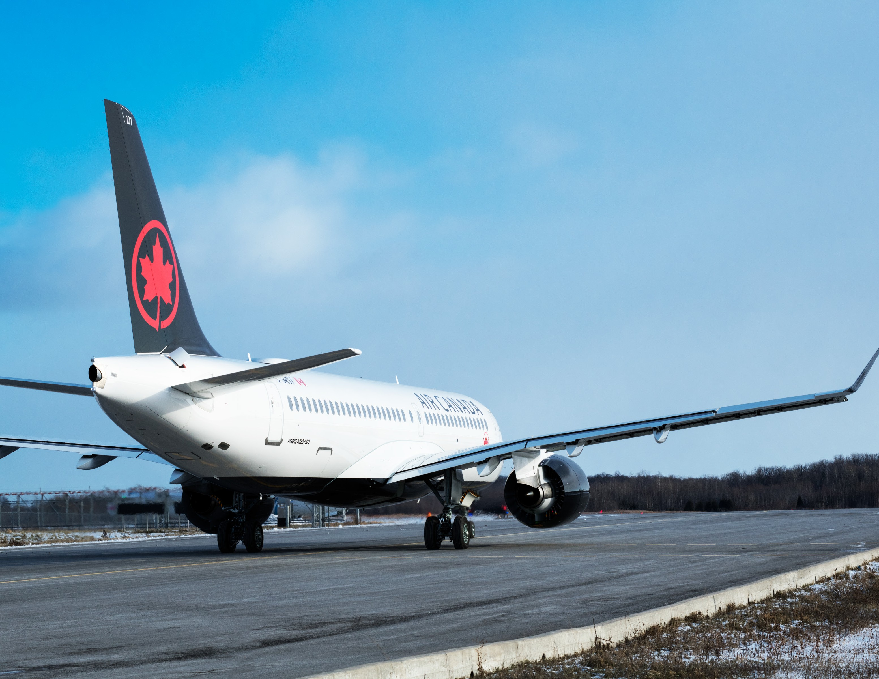
Overview | MARCH 2022 5
Principal Hubs
Air Canada’s three hubs, Toronto (YYZ), the primary global hub, Montreal (YUL), a principal gateway to French and other international markets, and Vancouver
(YVR), the airline’s premier gateway to the Asia-Pacific, offer Air Canada customers convenient connections under one roof.
—
Fleet Renewal
Air Canada’s fleet modernization program began in 2014 by adding next- generation, fuel efficient aircraft with industry leading customer amenities.
The ultra-efficient 787 Dreamliners now comprise nearly 50 per cent of the wide body fleet and deliver an approximate 20 per cent improvement in fuel efficiency over the aircraft they replaced. The Airbus A220-300 (formerly known as the Bombardier C Series) and 737 MAX 8 aircraft feature similar product specs and in-flight entertainment as the 787 Dreamliner. They are also expected to average approximately 20 per cent less fuel consumption per seat and emit 20 per cent less CO₂ and 50 per cent less nitrogen oxides than the aircraft they replace.

Slide 36

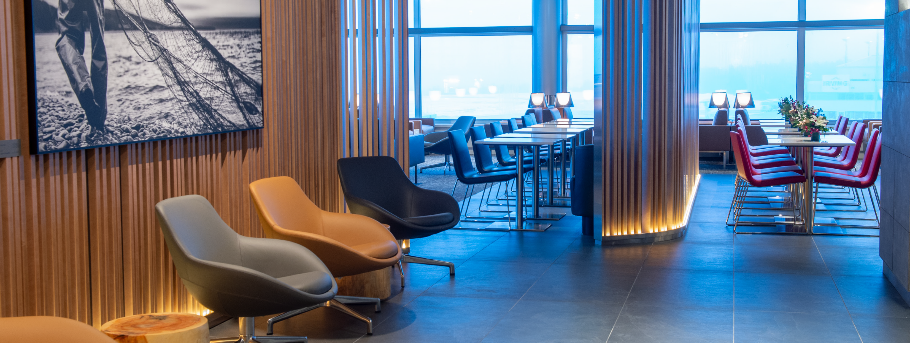
Overview | MARCH 2022 6
Premium Offerings
Air Canada Signature Service is an end-to- end premium service with lie-flat seats, access to airport concierge services at many airports, expedited check-in and security clearance (where available), priority baggage handling and preferential boarding. Customers also enjoy
Air Canada Maple Leaf Lounge pre-flight and access to the exclusive Air Canada Signature Suite.
Premium Economy cabin features enhanced comfort and amenities and is offered on all wide- body aircraft: 787 Dreamliners, Boeing 777-300ERs and -200LRs, and Airbus A330-300s.
Preferred Seats are offered in the Economy cabin for those who would like extra space between seats (up to 10 cm more) and convenience to board earlier and exit sooner on arrival.
The Air Canada Signature Suite has raised the bar with its five-star dining experience, setting a new standard for premium travel in North America. It is located in Terminal 1 at Toronto
Pearson and at Vancouver International Airport for select Signature Service customers travelling to international destinations.
Maple Leaf Lounges are a comfortable way to relax or catch up on work before take-off with services and amenities to make the pre-flight experience more pleasurable and productive. Lounge services also offer several touchless features, including presentation of all reading materials in digital format through PressReader and our AC @ La Table menu ordering app that allows customers to order hot snacks directly from their seat by simply scanning a QR code or tapping an NFC chip.
Air Canada Café, at Toronto Pearson offers a wide selection of specialty beverages to grab and go or to be enjoyed with complimentary Wi-Fi in a relaxed, bistro-type setting.
Air Canada Concierge services at 50 airports worldwide are available to Aeroplan Super Elite Members and, on day of travel at the airport, to Signature Service customers. Concierges are an immediate resource in-person at select airports and by phone 24/7 for all travel and airport-related matters, personalized services and priority.

Slide 37
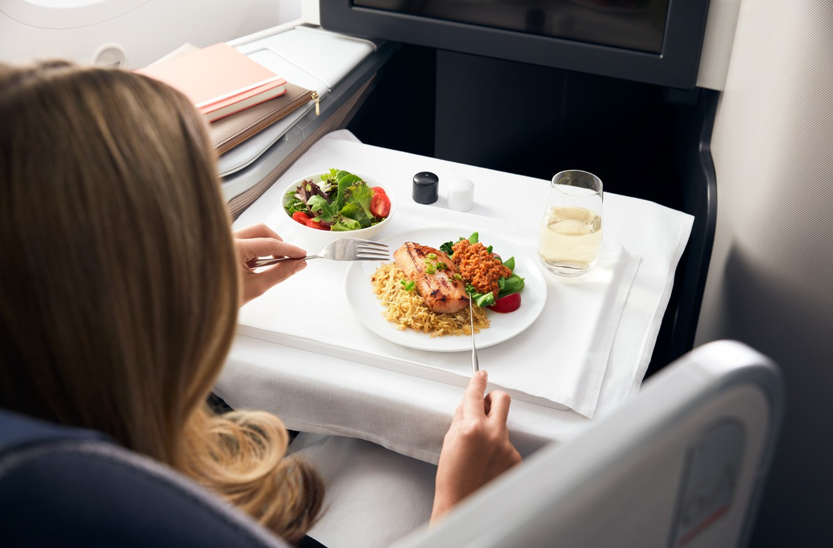
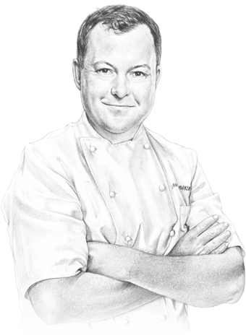

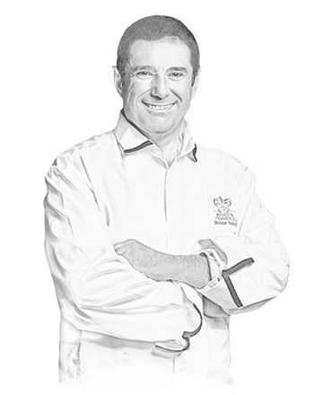

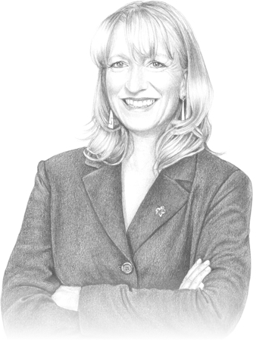
Overview | MARCH 2022 7
Culinary and Wine Talent
Air Canada’s panel of celebrated Canadian culinary and wine talent have designed award-winning food and wine options that guide the airline’s caterers.
Chef
David Hawksworth
creates signature dishes with Canadian flair that are exclusively featured on
Air Canada flights to Europe, Africa, and the Middle East in Signature Class and the Air Canada Signature Suite.
Chef
Antonio Park
prepares destination- inspired menu that are presented on select Air Canada flights from Canada to Asia and South America,
as well as in Signature Class – North America.
Chef
Jérôme Ferrer
designs meals for the airline’s Premium
Economy and Economy Class customers on all flights departing Canada for Europe and Asia, as well as Australia and South America.
Chef
Vikram Vij
creates modern Indian dishes for all cabins of service on Air Canada’s Canada-India flights from Toronto and Vancouver.
Sommelier
Véronique Rivest
is Air Canada’s sommelier. Her carefully hand-picked wines pair with food
at 30,000 feet.

Slide 38
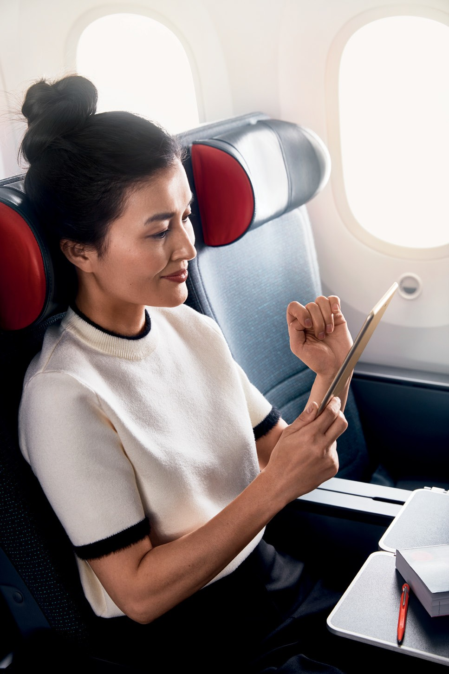

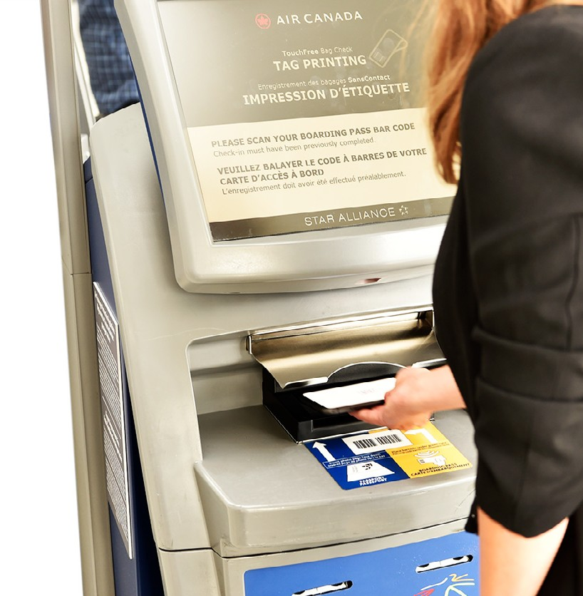
Overview | MARCH 2022 8
Online and App Services
Book flights, car rentals and hotel stays as well as purchase gift cards, flight passes and more online.
Self-service features are available to modify itineraries and purchase upgrades.
Check-in and verify flight status 24 hours prior to departure and confirm your contact information. Kiosks at most airports provide self-service at airport arrival.
Stay in contact with real-time mobile app updates. You will also be automatically signed up to receive alerts including gate and time information.
Self-manage your itinerary during severe weather and irregular operations with the “Self-Service Rebooking Tool” and follow travel alerts at aircanada.com/operationaloutlook .
Wi-Fi
Air Canada offers Wi-Fi access on select North American, Caribbean and
international flights. Customers can save by purchasing access before their flight or buy on board. With a Wi-Fi purchase, customers also receive complimentary access to 7,000+ magazines and
newspapers through the PressReader app. Find out if Wi-Fi is available on your next flight: (aircanada.com/wifi )

Slide 39
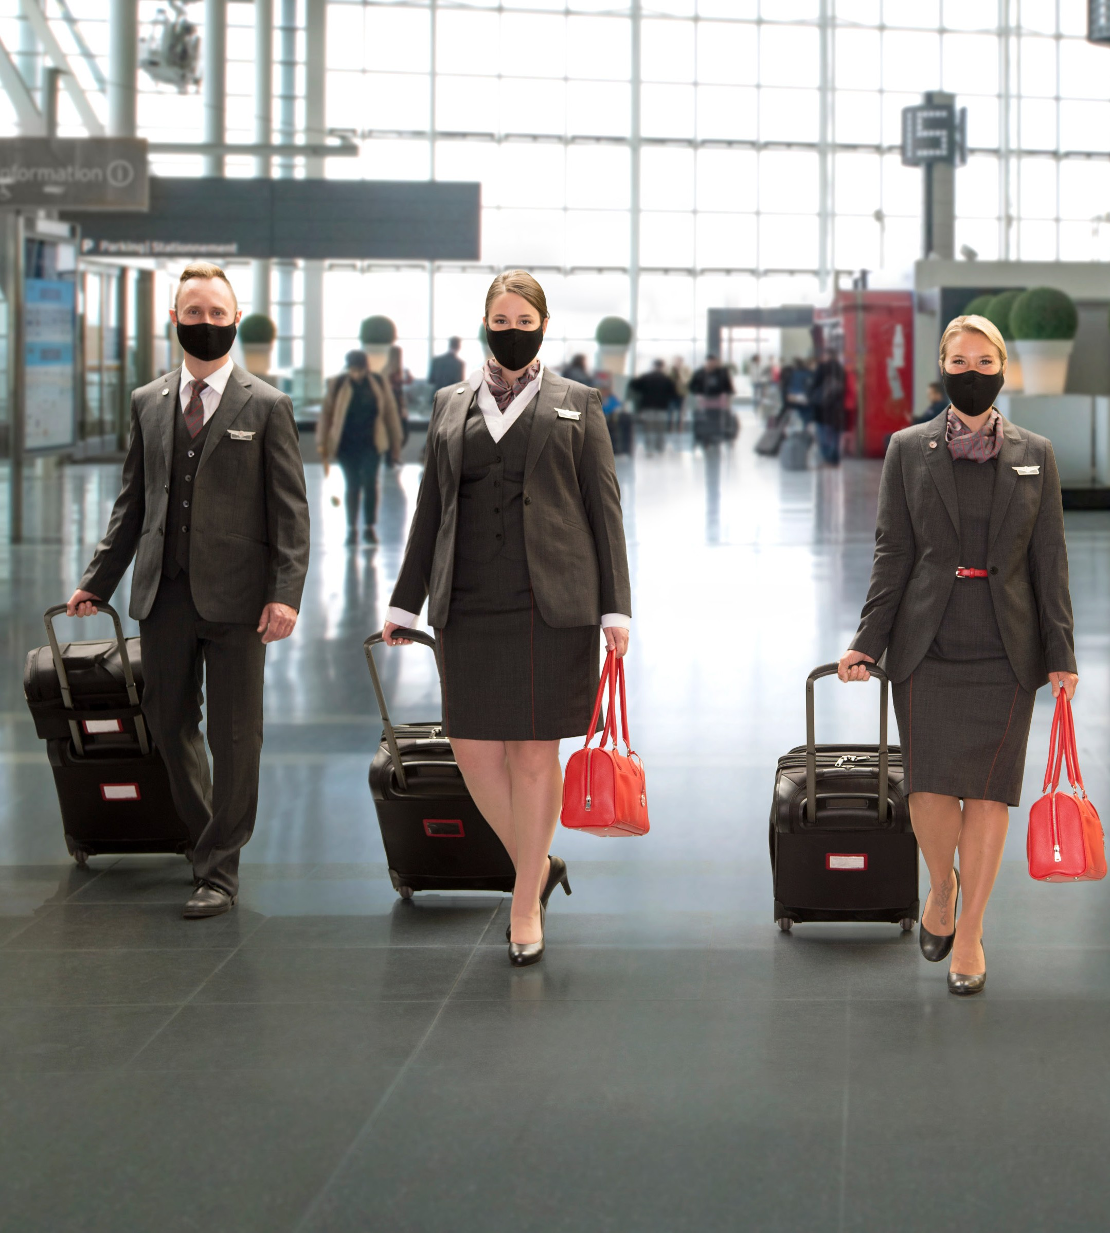
Overview | MARCH 2022 9
Air Canada Rouge
Air Canada Rouge service includes complimentary streaming entertainment, a premium cabin, specialized customer service, high-speed satellite Internet
on-board its Airbus A319, A320 and A321 fleet. With flights to leisure destinations in the U.S., the Caribbean and within Canada, Air Canada Rouge has served more than 30 million customers since launching on July 1, 2013.
—
Air Canada Express
Air Canada enhances its North American domestic and transborder network through a capacity purchase agreement with Jazz Aviation LP. This Canadian regional carrier operates flights on behalf of Air Canada under the Air Canada Express brand.
New Rouge Uniforms (2021-09)

Slide 40

Overview | MARCH 2022 10
Awards
In 2021, Air Canada was recognized for its people, products and services at the 2021 Skytrax World Airline Awards with honours for: Best Airline Staff in North America, Best Airline Staff in Canada, Best Business Class Lounge in North America, and Excellence for COVID-19.
In 2021, Air Canada received APEX’s Diamond Status Certification for the
Air Canada CleanCare+ biosafety program for managing COVID-19, the only airline in Canada to attain the highest APEX ranking.
Air Canada was named the 2018 Eco-Airline of the Year at the Air Transport World (ATW) 44th Annual Airline Industry Achievement Awards for being the first airline in the world to voluntarily join the World Bank’s IMF Carbon Pricing Leadership Coalition.
Air Canada is routinely at the top of employer awards, including Forbes World’s
Best Employers, Mediacorp’s Montreal Best Employers and Best Diversity Employers and Achiever’s Most Engaged Workplaces, among others.
Specialized Services
Family Travel – Customers with young children may take advantage of dedicated check-in counters at major hubs, complimentary on-board travel goodies, fun children’s meal options, and early boarding. Customers can register their children for free online at Air Canada Skyriders to receive additional travel goodies. (aircanada.com/familytraveltips )
Air Canada Vacations is a leading Canadian tour operator, offering all-inclusive packages featuring accommodation, roundtrip airfare on board Air Canada,
Air Canada Rouge, and its Star Alliance partners, Aeroplan flight rewards, as well as a wide assortment of cruises, tours and excursions. A repeat recipient of the Travel Media Agents’ “Choice Award for Favourite Tour Operator,” Air Canada Vacations
offers hundreds of destinations in the Caribbean, Mexico, Central and South America, Asia, Europe, and the U.S.
(aircanadavacations.com )
Jetz is Air Canada’s premium charter aviation service provider delivering superior Business Class service to satisfy the travel needs of professional sports teams, entertainment groups and corporate clients.
(aircanada.com/jetz )

Slide 41
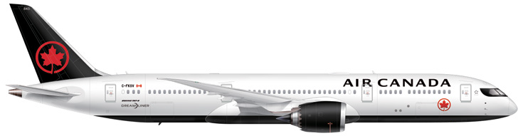
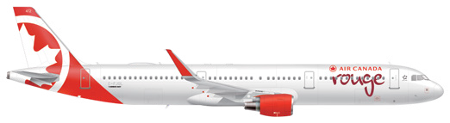
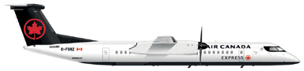
Overview | MARCH 2022 11
Fleet As of March 1, 2022
Air Canada |  |  | Air Canada Rouge |  |  | Air Canada Express
ON ORDER |  | OPERATING | ON ORDER |  | OPERATING | ON ORDER |  | OPERATING
Boeing 777-300ER |  | 18 | Airbus A321 |  | 14 | Embraer 175 |  | 25
Boeing 777-200LR |  | 6 | Airbus A320-200 |  | 5 | Mitsubishi CRJ-900 |  | 35
Boeing 787-8 |  | 8 | Airbus A319 |  | 20 | Mitsubishi CRJ 200 |  | 15
Boeing 787-9 | 3 | 29 |  |  |  | De Havilland Dash 8-400 |  | 39
Boeing 737 MAX 8 | 8 | 32
Airbus A330-300 |  | 16
Airbus A321 |  | 15
Airbus A320 |  | 18
Airbus A319 |  | 6
Airbus A220-300 | 18 | 27
TOTAL | 29 | 175 | - |  | 39 | - |  | 114
aircanada.com
Overview is produced by: Air Canada Corporate Communications
aircanada.com/media

Slide 42
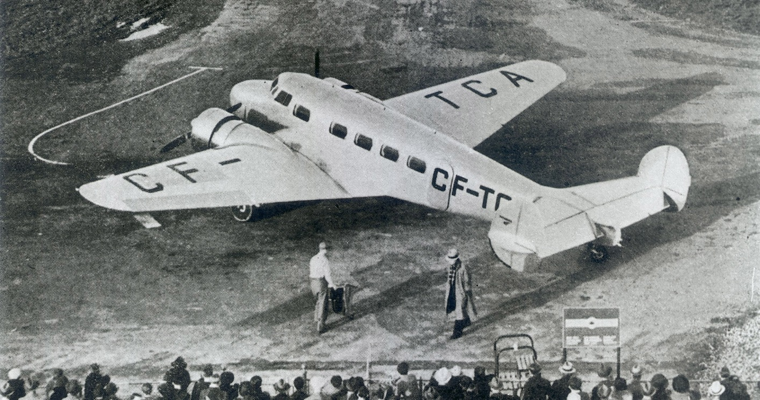
September 1 1937
First flight from Vancouver to Seattle

Slide 43
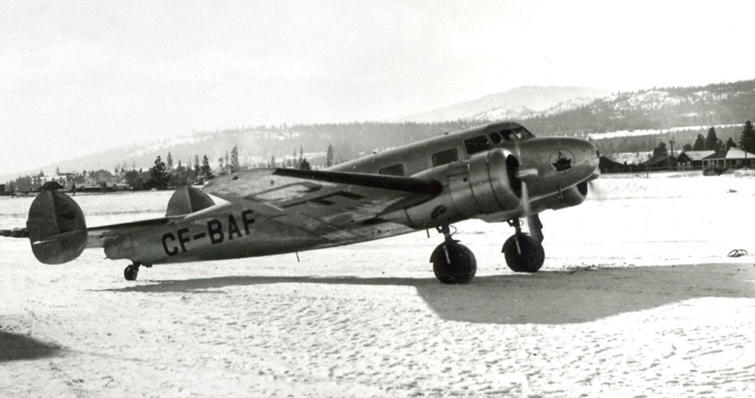
First airline to install alcohol de-icing nozzles
1938

Slide 44
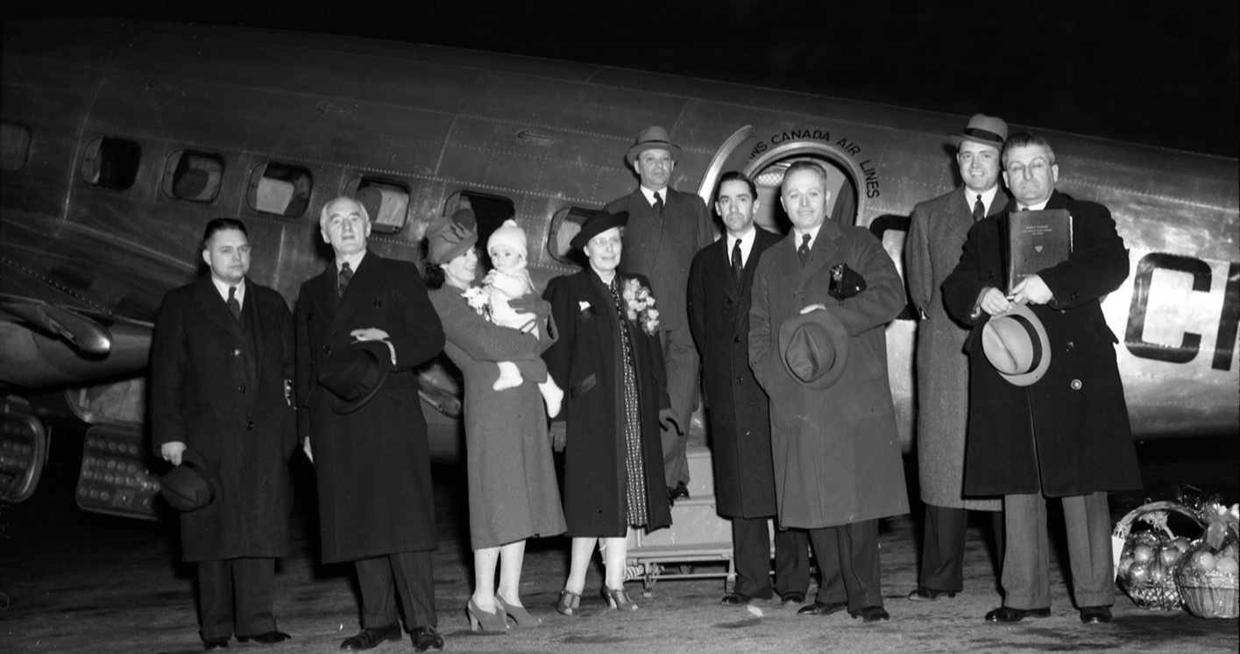
First trans-Atlantic flight, Montreal to Prestwick
1943

Slide 45
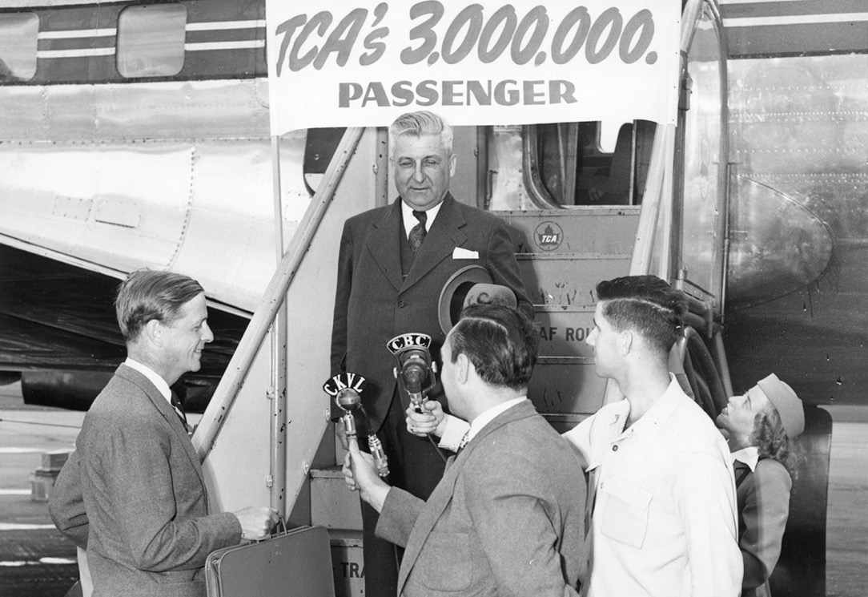
TCA’s 3 millionth passenger
July 1950
Notes:
By comparison last year alone we flew over 50 Million customers in a single year

Slide 46
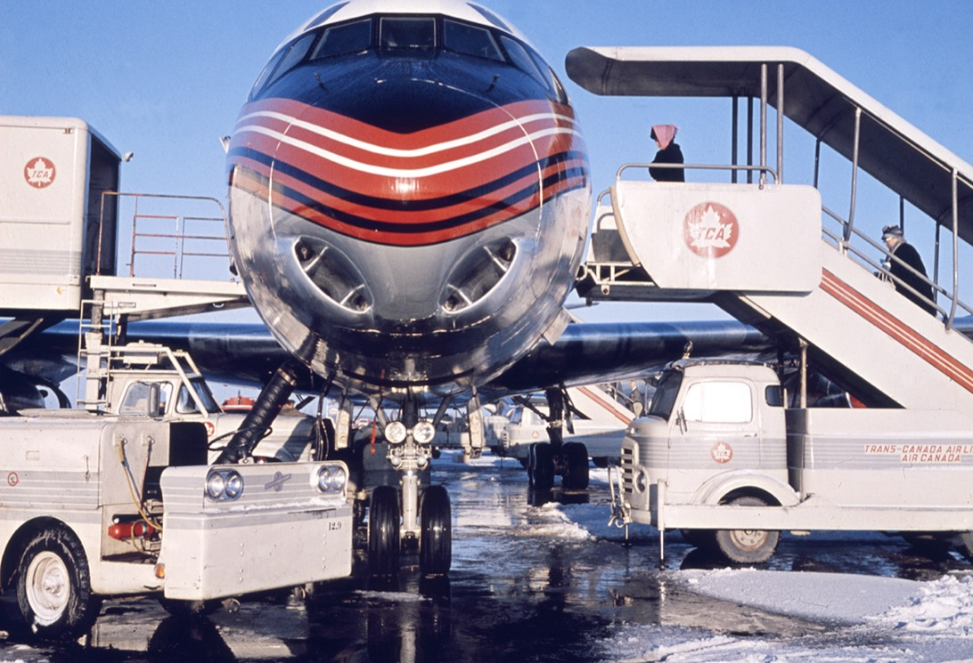
Installation of anti-skid brakes
1950s

Slide 47
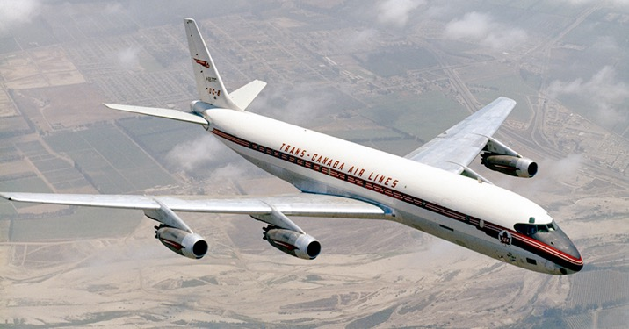

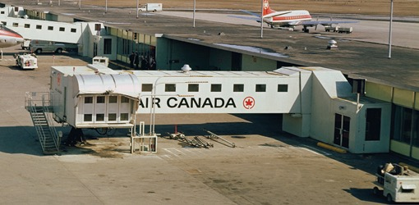
1960s
1963
Introduction of jet aircraft
1965
Covered walkways
Computerized reservation system

Slide 48
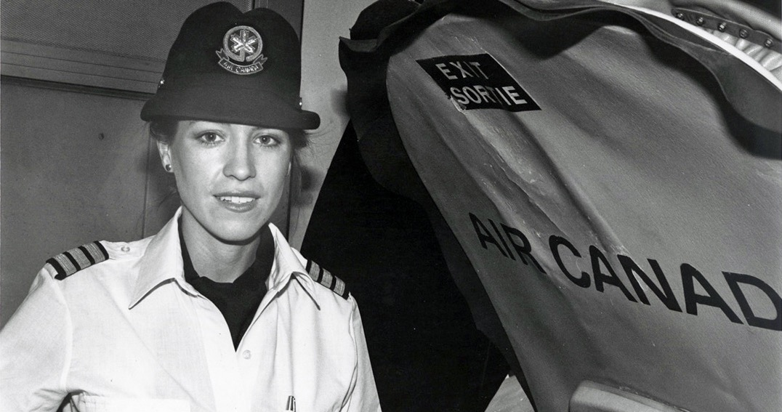
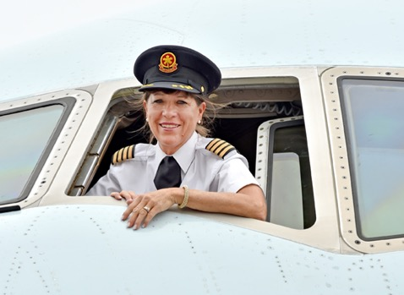
First female pilot, Captain Judy Cameron
1977
2015

Slide 49
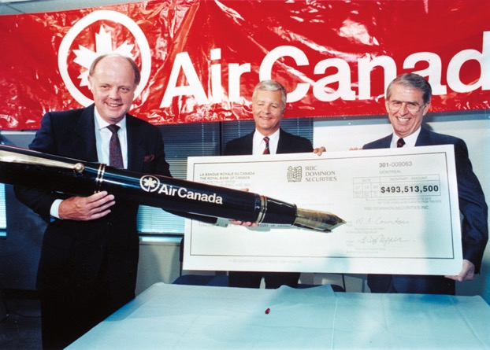
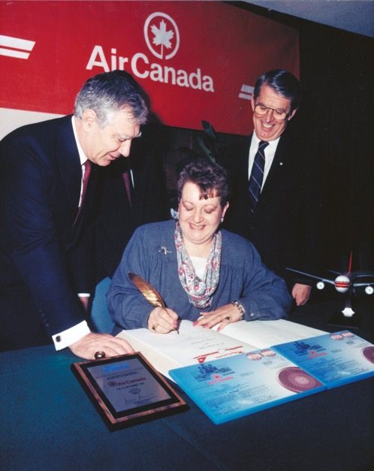

1988
Privatization of Air Canada

Slide 50
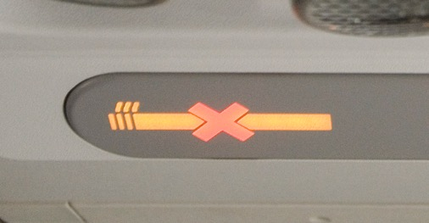
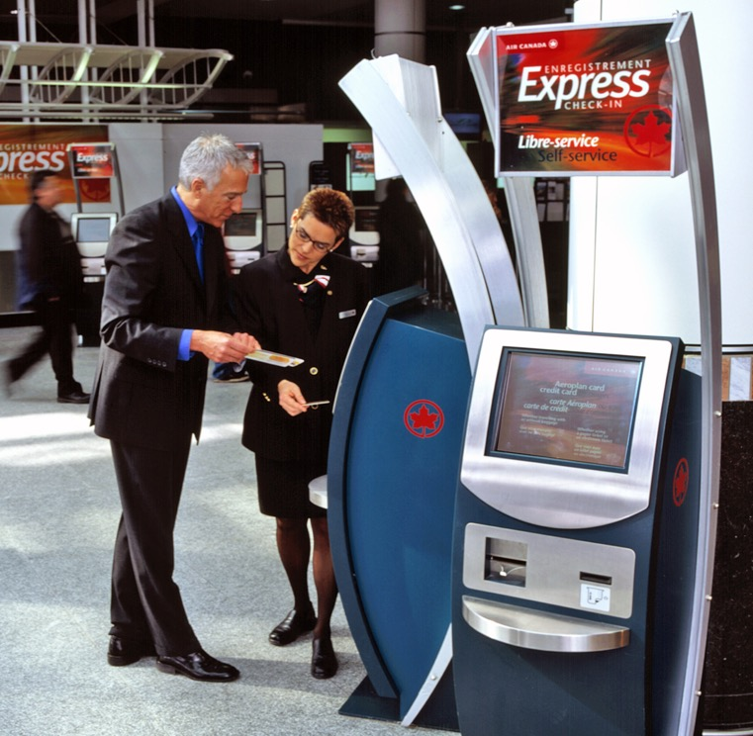
First carrier to make its European flights non-smoking
1990s
Debut of self-service kiosks

Slide 51
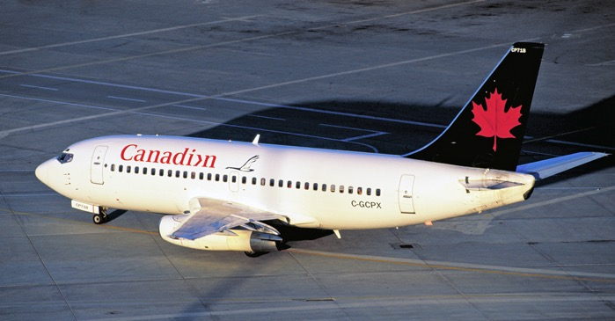
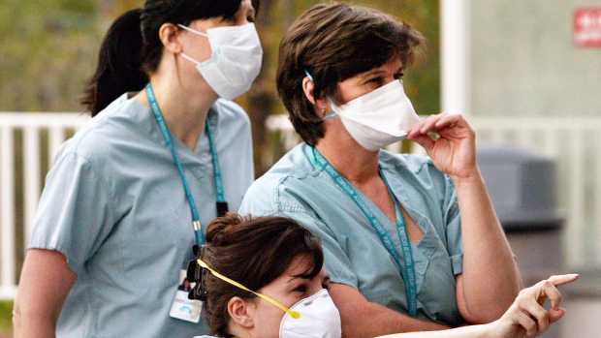

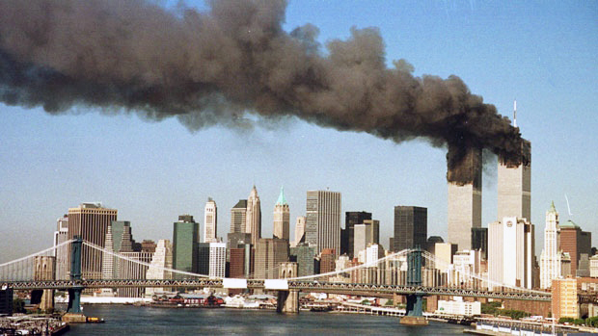
Merger with Canadian Airlines
SARS
Hostile takeover bid
9-11
2000s

Slide 52
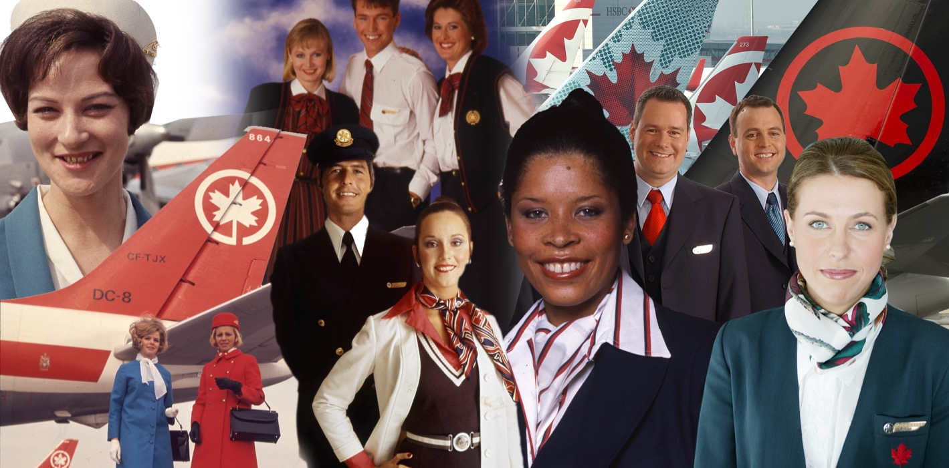
Celebrating over 80 years

Slide 53
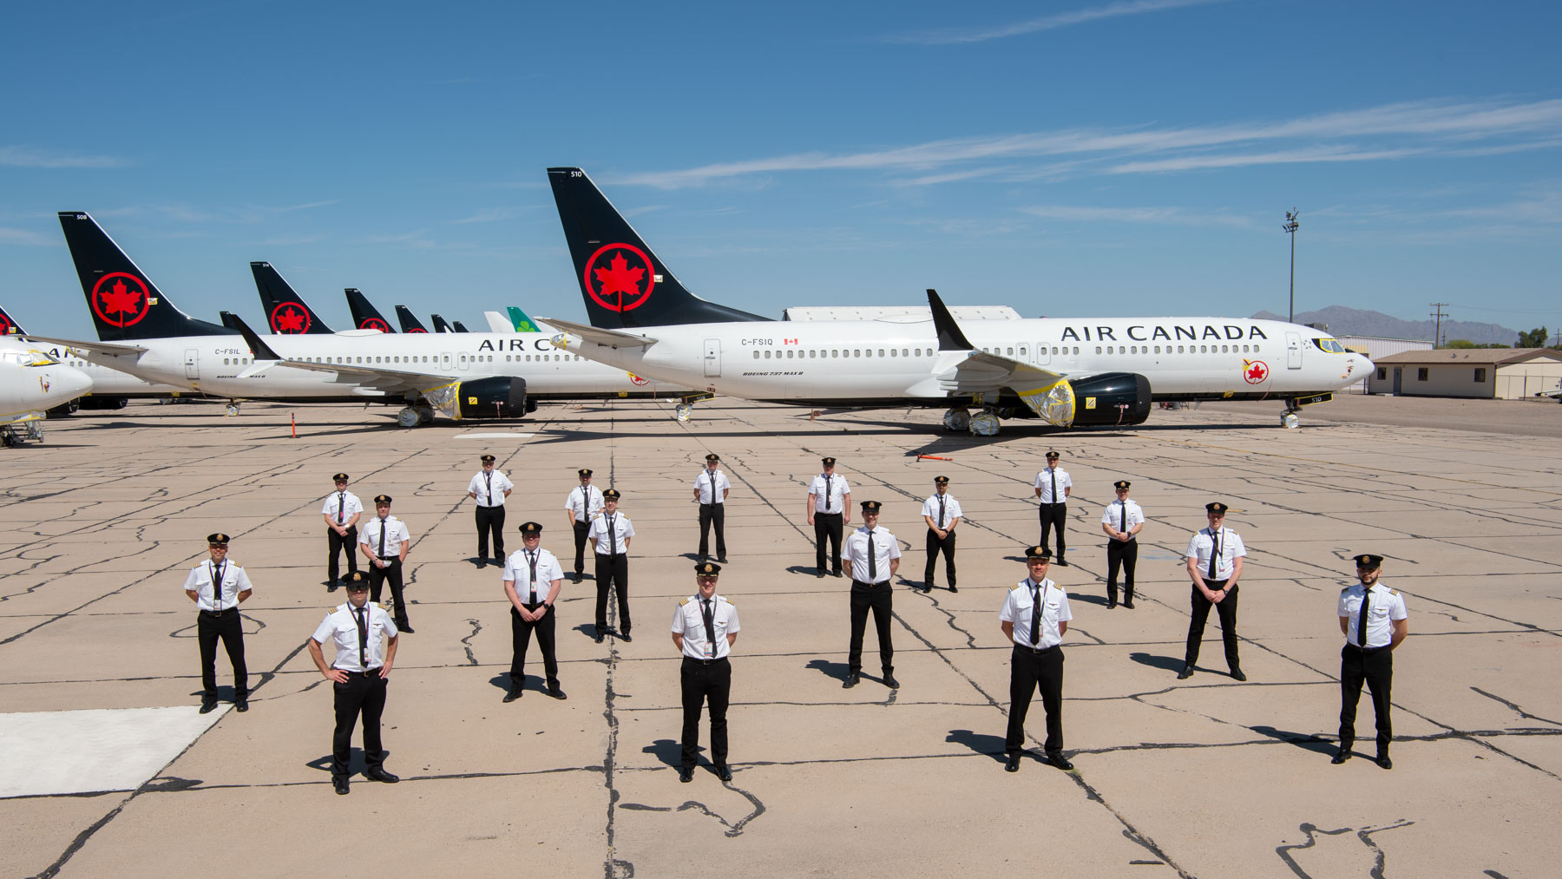
2020 – Covid 19 Unprecedented in Aviation history

